Slide 1


City of Santa Cruz
Comprehensive Water Cost of Service Study
City council
JUNE 14, 2016

Slide 2
Agenda
Rate Setting 101
Key Assumptions
Rate Setting Legal Environment/Overview
Review Proposed Tier Definition
Customer impacts
Review 5 Years of Proposed Rates

Slide 3
Steps in Conducting a Rate Study
Cost of Service
& Rate Design
  Cost allocations
  Rate design
    Rate calculations
    Customer impact analyses
Final Rate Adoption
  Report
  Prop 218 Notice
  Public Hearing
Financial Plan
  Evaluation of CIP and financing options
  Cash flow analysis for financial sufficiency
Rate Setting Framework
  Financial goals and policies
  Pricing objectives

Slide 4
Key Assumptions
Estimated Usage of 2.5 BGY
  (reduced 2013 usage by approximately 17%)
Base Revenue Requirements of $25,915,101
  Assumes a full fiscal year
Infrastructure Reinvestment fee (IRF) Requirements of $7,794,919
  Assumes a full fiscal year
Outside / Inside Customer difference is 14.5%
  Based on asset allocation between inside and outside customers
Notes:
Model will show different numbers:
Base Revenue = 25,915,101
IRF = 7,794,919

Slide 5
Financial Impact
Based on usage of 2.5 BGY under the current rate structure and FY 2017 rates, the City will collect $28.4M
  Does not include drought rates / revenue
The proposed financial plan will collect ~$33.7M ($25.9M + $7.8M)
This is an 19% increase in overall rates
In addition, the change in inside/outside surcharge from ~28% to 14.5% results in an increase to the inside customers of approximately 5%
Note the overall affect is ~21% increase for inside customer

Slide 6
5 Year Financial Plan
 | FYE 2017 | FYE 2017 | FYE 2018 | FYE 2019 | FYE 2020 | FYE 2021
O&M Rev Req | $28,418,253 | $25,915,101 | $28,128,488 | $30,059,525 | $31,604,455 | $33,241,638
IRF Rev Req | N/A | $7,794,919 | $8,700,797 | $9,166,040 | $10,169,506 | $11,239,068
Rate Stab Req | N/A | $0 | $3,342,244 | $3,342,244 | $3,342,244 | $3,342,244
Total Rev Requirement | $28,418,253 | $33,710,020 | $40,171,529 | $42,567,809 | $45,116,205 | $47,822,950
Overall % Change |  | 19% | 19% | 6% | 6% | 6%
Note:
FY 2017 rates will be implemented in Oct 2016. Revenues generated in this fiscal year will be 3 month adopted 2017 rates and 9 month of proposed rates. Revenues are projected to be ~$32.3M

Slide 7
Legal Environment of Rate Making
Cost of Service Requirements
  Proposition 218 and Proposition 26 (Article XIIIC and XIIID of California Constitution)
  California Government Code 54999
Pass-through Provision
  AB 3030 – Section 53756 of the Government Code
Water Conservation
  Article X of California Constitution
  CA Water Code Chapter 3.4 – Allocation-based Conservation Water Pricing (AB 2882)

Slide 8
Tier Definition
Given the current legal climate, Tier break points need to have a clear and logical rationale
Average Winter use – used as a proxy to determine indoor household needs for lowest cost water (Tier 1)
Average Summer use – average indoor use plus outdoor needs (Tier 3)
 | Current | Proposed | Tier Break Rationale
Tier 1 | 0-4 units | 0-5 units | Average Winter usage
Tier 2 | 5-9 units | 6-7 units | Average Fall usage
Tier 3 | 10-14 units | 8-9 units | Average Summer Usage
Tier 4 | 15-18 Units | 10 & above
Tier 5 | 19 & above

Slide 9
Summary of Proposed Rate Structure
Proposed Rate Structures
  SFR – Inclining Tiers
    4 Tiers:
      Tier 1: 0 to 5ccf
      Tier 2: 6 to 7ccf
      Tier 3: 8 to 9 ccf
      Tier 4: 10+ ccf
  MFR – Same Tiered rates as SFR but based on # of DU’s
  COM,UCSC, and North Coast Ag –Uniform
  Landscape – Simple Water Budget

Slide 10
Pricing Objectives
Rankings | Pricing Objectives
Most Important | Revenue Sufficiency
Very Important | Promotes Efficiency
 | Revenue Stability
 | Perceived to be Fair to the Public
 | Affordability for Essential Use
 | Customer Understanding
 | Promotes Conservation
 | Rate Stability
Notes:
Includes the City Council and Water Commission Rankings

Slide 11
Proposed Rate Structure
Shift revenues away from fixed charge to commodity
  Current: 36% fixed and 64% variable
  Proposed: 8% fixed and 92% variable
    Promotes water efficiency / conservation
    Affordability for essential use
    Perceived fair to the public
Rate Stabilization charge to enhance revenue stability
  Begins in FY 2018
  Consists of a uniform commodity charge of $1.00 per ccf

Slide 12
Proposed 5 Years Rates
Inside – Fixed Rates
Inside |  | FY 2017 | FY 2018 | FY 2019 | FY 2020 | FY 2021
Meter Size | # of Meters | Proposed Ready-to-Serve ($/Meter)
5/8-in | 14,348 | $ 8.78 | $ 9.53 | $ 10.18 | $ 10.71 | $ 11.26
3/4-in | 150 | $ 9.01 | $ 9.78 | $ 10.45 | $ 10.99 | $ 11.56
1-in | 748 | $ 9.70 | $ 10.53 | $ 11.25 | $ 11.83 | $ 12.44
1 1/2-in | 294 | $ 10.61 | $ 11.52 | $ 12.31 | $ 12.94 | $ 13.61
2-in | 250 | $ 13.14 | $ 14.26 | $ 15.24 | $ 16.02 | $ 16.85
3-in | 35 | $ 31.74 | $ 34.45 | $ 36.82 | $ 38.71 | $ 40.71
4-in | 15 | $ 38.63 | $ 41.93 | $ 44.81 | $ 47.11 | $ 49.55
6-in | 6 | $ 54.70 | $ 59.37 | $ 63.45 | $ 66.71 | $ 70.16
8-in | 3 | $ 73.07 | $ 79.31 | $ 84.76 | $ 89.11 | $ 93.73
10-in | 3 | $ 93.74 | $ 101.75 | $ 108.73 | $ 114.32 | $ 120.24

Slide 13
Proposed 5 Years Rates
Outside – Fixed Rates
Outside |  | FY 2017 | FY 2018 | FY 2019 | FY 2020 | FY 2021
Meter Size | # of Meters | Proposed Ready-to-Serve ($/Meter)
5/8-in | 7,507 | $ 10.05 | $ 10.91 | $ 11.66 | $ 12.26 | $ 12.89
3/4-in | 65 | $ 10.32 | $ 11.20 | $ 11.97 | $ 12.59 | $ 13.24
1-in | 574 | $ 11.11 | $ 12.06 | $ 12.89 | $ 13.55 | $ 14.25
1 1/2-in | 164 | $ 12.16 | $ 13.20 | $ 14.10 | $ 14.83 | $ 15.60
2-in | 157 | $ 15.05 | $ 16.34 | $ 17.46 | $ 18.35 | $ 19.30
3-in | 14 | $ 36.36 | $ 39.47 | $ 42.17 | $ 44.34 | $ 46.64
4-in | 9 | $ 44.25 | $ 48.03 | $ 51.33 | $ 53.96 | $ 56.76
6-in | 5 | $ 62.66 | $ 68.01 | $ 72.68 | $ 76.42 | $ 80.37
8-in | 1 | $ 83.71 | $ 90.86 | $ 97.10 | $ 102.09 | $ 107.38
10-in | - | $ 107.38 | $ 116.55 | $ 124.55 | $ 130.95 | $ 137.74

Slide 14
Total Proposed Commodity Charge
Notes:
Don’t show usage

Slide 15
Total Proposed Commodity Charge
Notes:
Don’t Show usage

Slide 16
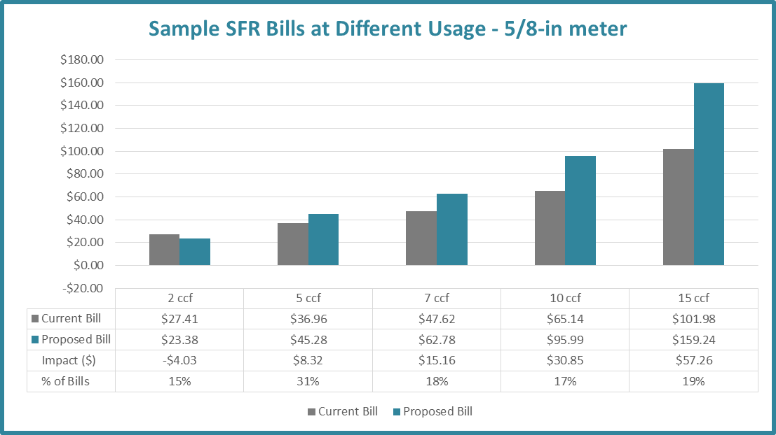
Customer Impact for Single Family

Slide 17
5 Year Rate Impact for Single Family – 5/8” Meter
Consumption | July 2016 Adopted | Oct 2016 Proposed | July 2017 Proposed | July 2018 Proposed | July 2019 Proposed | July 2020 Proposed
2 ccf | $27.41 | $23.38 | $27.47 | $29.14 | $30.77 | $32.46
7 ccf | $47.62 | $62.78 | $75.50 | $79.94 | $84.58 | $89.42
15 ccf | $101.98 | $159.24 | $189.04 | $200.26 | $212.58 | $225.68

Slide 18
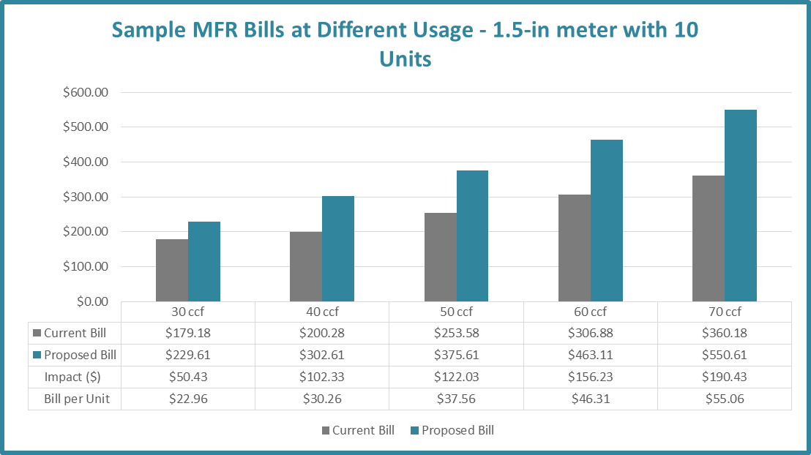
Customer Impact for Multi-Family
10 units and 1.5” meter

Slide 19
5 Year Rate Impact for Multi-Family 10 units with 1.5” Meter
Consumption | July 2016 Adopted | Oct 2016 Proposed | July 2017 Proposed | July 2018 Proposed | July 2019 Proposed | July 2020 Proposed
30 ccf | $179.18 | $229.61 | $280.62 | $296.71 | $313.84 | $331.61
40 ccf | $200.28 | $302.61 | $370.32 | $391.51 | $414.14 | $437.61
50 ccf | $253.58 | $375.61 | $460.02 | $486.31 | $514.44 | $543.61
60 ccf | $306.88 | $463.11 | $565.62 | $598.11 | $633.04 | $669.41
70 ccf | $360.18 | $550.61 | $671.22 | $709.91 | $751.64 | $795.21

Slide 20
Next Steps
Proceed with the Prop 218 Notice
RFC to develop the Administrative Record / Report
Public Hearing on August 23rd

Slide 21
Discussion

Slide 22
Option 1A – 90% Variable / 10% Fixed
Inside Fixed Charge
Meter Size | Proposed Inside Ready-to-Serve ($/Meter) | Current Inside | Difference ($) | Difference (%)
5/8-in | $8.78 | $23.19 | -$14.28 | -62%
3/4-in | $9.01 | $23.19 | -$14.04 | -61%
1-in | $9.70 | $57.94 | -$48.09 | -83%
1 1/2-in | $10.61 | $115.88 | -$105.10 | -91%
2-in | $13.14 | $185.38 | -$172.03 | -93%
3-in | $31.74 | $347.59 | -$315.35 | -91%
4-in | $38.63 | $579.32 | -$540.08 | -93%
6-in | $54.70 | $1,158.60 | -$1,103.03 | -95%
8-in | $73.07 | $2,664.74 | -$2,590.51 | -97%
10-in | $93.74 | $3,290.36 | -$3,195.14 | -97%

Slide 23
Option 1A – 90% Variable / 10% Fixed
Outside Fixed Charge
Meter Size | Proposed Outside Ready-to-Serve ($/Meter) | Current Outside | Difference ($) | Difference (%)
5/8-in | $10.05 | $29.56 | -$19.35 | -65%
3/4-in | $10.32 | $29.56 | -$19.08 | -65%
1-in | $11.11 | $73.88 | -$62.60 | -85%
1 1/2-in | $12.16 | $147.72 | -$135.37 | -92%
2-in | $15.05 | $236.35 | -$221.06 | -94%
3-in | $36.36 | $443.17 | -$406.24 | -92%
4-in | $44.25 | $738.62 | -$693.67 | -94%
6-in | $62.66 | $1,477.21 | -$1,413.56 | -96%
8-in | $83.71 | $3,398.51 | -$3,313.49 | -97%
10-in | $107.38 | $4,195.23 | -$4,086.16 | -97%

Slide 24
Justification for Tiered Rates
Inside City
Commodity | Proposed Tier |  | Water Supply | Treatment | Delivery | Peaking | Conservation | IRF | Proposed FY2017 Rate ($/ccf)
SFR & MFR
Tier 1 | 0-5 |  | $1.76 | $0.46 | $2.17 | $1.35 | $0.00 | $1.55 | $7.30
Tier 2 | 6-7 |  | $1.76 | $0.46 | $2.17 | $2.03 | $0.00 | $2.32 | $8.75
Tier 3 | 8-9 |  | $1.76 | $0.46 | $2.17 | $2.51 | $0.51 | $2.86 | $10.28
Tier 4 | & Above |  | $1.76 | $0.46 | $2.17 | $3.37 | $1.03 | $3.85 | $12.65
COM
Uniform | Uniform |  | $1.76 | $0.46 | $2.17 | $1.98 | $0.20 | $2.27 | $8.84
UCSC
Uniform | Uniform |  | $1.76 | $0.46 | $2.17 | $2.10 | $0.21 | $2.40 | $9.11
North Coast AG
Uniform | Uniform |  | $1.76 | $0.00 | $1.55 |  | $0.27 | $3.05 | $6.63
Landscape
Tier 1 | 100% of TWB* |  | $1.76 | $0.46 | $2.17 | $2.46 | $0.00 | $2.82 | $9.68
Tier 2 | 150% of TWB |  | $1.76 | $0.46 | $2.17 | $3.69 | $1.07 | $4.22 | $13.38
Tier 3 | & Above |  | $1.76 | $0.46 | $2.17 | $3.74 | $2.14 | $4.27 | $14.54
Elevation Surcharge
Elevation |  | Uniform |  |  |  |  |  |  | $0.42

Slide 25
Justification for Tiered Rates
Outside City
Commodity | Proposed Tier | Water Supply | Treatment | Delivery | Peaking | Conservation | IRF | Proposed Rate ($/ccf)
SFR & MFR
Tier 1 | 0-5 | $2.02 | $0.53 | $2.48 | $1.56 | $0.00 | $1.78 | $8.38
Tier 2 | 6-7 | $2.02 | $0.53 | $2.48 | $2.34 | $0.00 | $2.68 | $10.05
Tier 3 | 8-9 | $2.02 | $0.53 | $2.48 | $2.89 | $0.62 | $3.30 | $11.85
Tier 4 | & Above | $2.02 | $0.53 | $2.48 | $3.89 | $1.23 | $4.44 | $14.60
COM
Uniform | Uniform | $2.02 | $0.53 | $2.48 | $2.27 | $0.23 | $2.59 | $10.13
Landscape
Tier 1 | 100% of TWB* | $2.02 | $0.53 | $2.48 | $2.82 | $0.00 | $3.23 | $11.09
Tier 2 | 150% of TWB | $2.02 | $0.53 | $2.48 | $4.23 | $1.22 | $4.83 | $15.32
Tier 3 | & Above | $2.02 | $0.53 | $2.48 | $4.28 | $2.45 | $4.89 | $16.66
Elevation Surcharge
Elevation | Uniform |  |  |  |  |  |  | $0.48

Slide 26
Option 1A
Inside Commodity Rates
Commodity | Proposed Tier | O&M Rates | IRF Rates | Total Inside Commodity Rate | Current Commodity Rate
SFR
Tier 1 | 0-5 | $5.75 | $1.55 | $7.30 | $2.11
Tier 2 | 6-7 | $6.42 | $2.32 | $8.75 | $5.33
Tier 3 | 8-9 | $7.41 | $2.87 | $10.28 | $6.86
Tier 4 | & Above | $8.80 | $3.86 | $12.65 | $9.40
Tier 5 |  |  |  |  | $11.71
MFR
Tier 1 | 0-5 | $5.75 | $1.55 | $7.30 | $5.33
Tier 2 | 6-7 | $6.42 | $2.32 | $8.75 | $5.33
Tier 3 | 8-9 | $7.41 | $2.87 | $10.28 | $5.33
Tier 4 | & Above | $8.80 | $3.86 | $12.65 | $5.33
Tier 5 |  |  |  |  | $5.33
COM
Uniform | Uniform | $6.57 | $2.27 | $8.84 | $5.33
UCSC
Uniform | Uniform | $6.70 | $2.40 | $9.11 | $5.33
North Coast AG
Uniform | Uniform | $3.58 | $3.05 | $6.63 | $1.70
Landscape
Tier 1 | 100% of TWB* | $6.86 | $2.82 | $9.68 | $5.33
Tier 2 | 150% of TWB | $9.15 | $4.22 | $13.38 | $5.33
Tier 3 | & Above | $10.27 | $4.27 | $14.54 | $5.33
Elevation Surcharge
Elevation Surcharge |  |  |  | $0.42 | $0.20
*Total Water Budget

Slide 27
Option 1A
Outside Commodity Rates
Commodity | Proposed Tier | O&M Rates | IRF Rates | Proposed Outside Commodity Rate | Current Commodity Rate
SFR
Tier 1 | 0-5 | $6.59 | $1.78 | $8.38 | $2.67
Tier 2 | 6-7 | $7.37 | $2.68 | $10.05 | $6.80
Tier 3 | 8-9 | $8.54 | $3.31 | $11.85 | $8.74
Tier 4 | & Above | $10.15 | $4.44 | $14.60 | $11.96
Tier 5 |  |  |  |  | $14.94
MFR
Tier 1 | 0-5 | $6.59 | $1.78 | $8.38 | $6.80
Tier 2 | 6-7 | $7.37 | $2.68 | $10.05 | $6.80
Tier 3 | 8-9 | $8.54 | $3.31 | $11.85 | $6.80
Tier 4 | & Above | $10.15 | $4.44 | $14.60 | $6.80
Tier 5 |  |  |  |  | $6.80
COM
Uniform | Uniform | $7.53 | $2.60 | $10.13 | $6.80
UCSC
Uniform | Uniform | N/A |  |  | $6.80
North Coast AG
Uniform | Uniform | N/A |  |  | $1.70
Landscape
Tier 1 | 100% of TWB | $7.85 | $3.23 | $11.09 | $6.80
Tier 2 | 150% of TWB | $10.48 | $4.84 | $15.32 | $6.80
Tier 3 | & Above | $11.76 | $4.90 | $16.66 | $6.80
Elevation Surcharge
Elevation Surcharge |  |  |  | $0.48 | $0.20

Slide 28
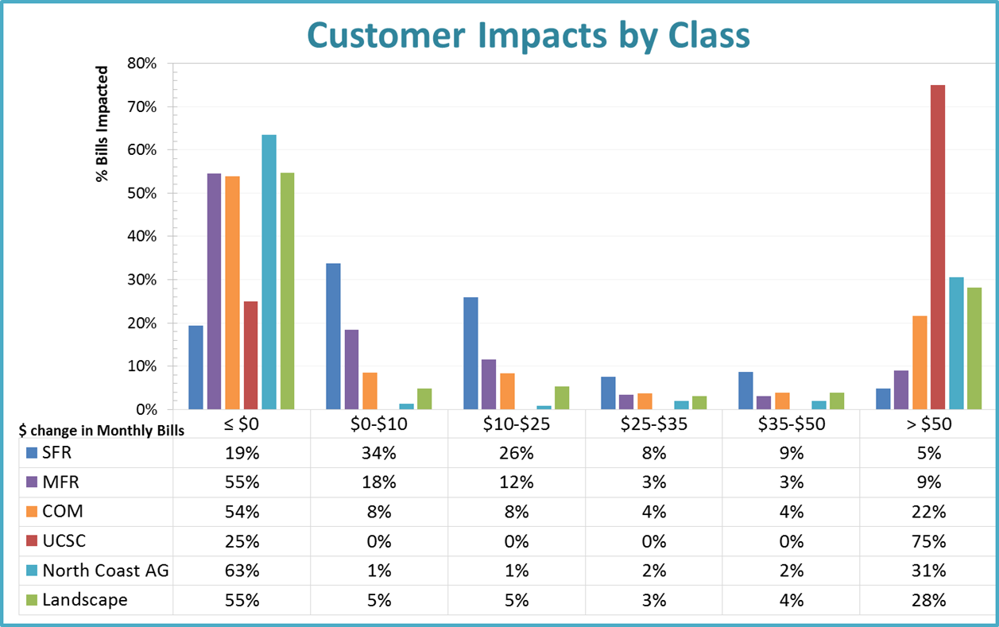
Option 1A – 90% Variable / 10% Fixed
Customer Impacts by Class ($)

Slide 29
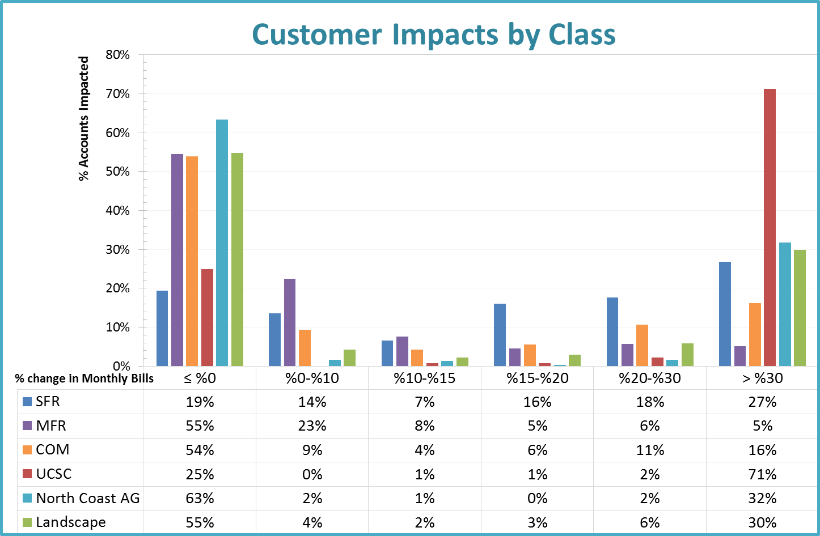
Option 1A – 90% Variable / 10% Fixed
Customer Impacts (%)

Slide 30
Proposed 5 Year Rates
Inside – O&M Component

Slide 31
Proposed 5 Year Rates
Outside – O&M Component

Slide 32
Proposed 5 Year Rates
Inside - IRF Component

Slide 33
Proposed 5 Year Rates
Outside - IRF Component

Slide 34
Appendix

Slide 35
Option 1B
90% Variable / 10% Fixed
IRF – 100% Fixed – AWWA Meter

Slide 36
Option 1B – 90% Variable / 10% Fixed
Impact
IRF Component increases the Fixed Meter Charge
Based on AWWA Meter Ratios
Inside impact shown in table to the right
Meter Size | IRF ($/Meter)
5/8-in | $17.81
3/4-in | $26.71
1-in | $44.52
1 1/2-in | $89.03
2-in | $142.44
3-in | $311.58
4-in | $560.83
6-in | $1,424.33
8-in | $2,492.58
10-in | $3,738.87

Slide 37
Option 1B - 90% Variable / 10% Fixed
Inside Fixed Charge
Meter Size | Proposed Inside Fixed ($/Meter) | Current Inside | Difference ($) | Difference (%)
5/8-in | $26.59 | $23.19 | $3.10 | 13%
3/4-in | $35.72 | $23.19 | $12.32 | 53%
1-in | $54.22 | $57.94 | -$3.91 | -7%
1 1/2-in | $99.64 | $115.88 | -$12.48 | -11%
2-in | $155.58 | $185.38 | -$19.65 | -11%
3-in | $343.32 | $347.59 | $0.01 | 0%
4-in | $599.46 | $579.32 | $38.66 | 7%
6-in | $1,479.03 | $1,158.60 | $355.80 | 31%
8-in | $2,565.65 | $2,664.74 | -$113.90 | -4%
10-in | $3,832.61 | $3,290.36 | $525.68 | 16%

Slide 38
Option 1B - 90% Variable / 10% Fixed
Outside Fixed Charge
Meter Size | Proposed Outside Fixed ($/Meter) | Current Outside | Difference ($) | Difference (%)
5/8-in | $30.45 | $29.56 | $0.55 | 2%
3/4-in | $40.92 | $29.56 | $11.11 | 38%
1-in | $62.10 | $73.88 | -$12.00 | -16%
1 1/2-in | $114.14 | $147.72 | -$29.28 | -20%
2-in | $178.21 | $236.35 | -$46.52 | -20%
3-in | $393.27 | $443.17 | -$45.00 | -10%
4-in | $686.68 | $738.62 | -$30.73 | -4%
6-in | $1,694.22 | $1,477.21 | $257.52 | 17%
8-in | $2,938.93 | $3,398.51 | -$476.56 | -14%
10-in | $4,390.21 | $4,195.23 | $176.00 | 4%

Slide 39
Option 1B
Inside Commodity Rates
Commodity | Proposed Tier | Proposed Commodity Rate | Current Commodity Rate
SFR
Tier 1 | 0-5 | $5.75 | $2.11
Tier 2 | 6-7 | $6.43 | $5.33
Tier 3 | 8-9 | $7.42 | $6.86
Tier 4 | & Above | $8.80 | $9.40
Tier 5 |  |  | $11.71
MFR
Tier 1 | 0-5 | $5.75 | $5.33
Tier 2 | 6-7 | $6.43 | $5.33
Tier 3 | 8-9 | $7.42 | $5.33
Tier 4 | & Above | $8.80 | $5.33
Tier 5 |  |  | $5.33
COM
Uniform | Uniform | $6.58 | $5.33
UCSC
Uniform | Uniform | $6.71 | $5.33
North Coast AG
Uniform | Uniform | $3.58 | $1.70
Landscape
Tier 1 | 100% of TWB* | $6.86 | $5.33
Tier 2 | 150% of TWB | $9.16 | $5.33
Tier 3 | & Above | $10.27 | $5.33
Elevation Surcharge
Elevation Surcharge |  | $0.42 | $0.20

Slide 40
Option 1B
Outside Commodity Rates
Commodity | Proposed Tier | Proposed Outside Commodity Rate | Current Commodity Rate
SFR
Tier 1 | 0-5 | $6.60 | $2.67
Tier 2 | 6-7 | $7.38 | $6.80
Tier 3 | 8-9 | $8.54 | $8.74
Tier 4 | & Above | $10.16 | $11.96
Tier 5 |  |  | $14.94
MFR
Tier 1 | 0-5 | $6.60 | $6.80
Tier 2 | 6-7 | $7.38 | $6.80
Tier 3 | 8-9 | $8.54 | $6.80
Tier 4 | & Above | $10.16 | $6.80
Tier 5 |  |  | $6.80
COM
Uniform | Uniform | $7.53 | $6.80
UCSC
Uniform | Uniform | N/A | $6.80
North Coast AG
Uniform | Uniform | N/A | $1.70
Landscape
Tier 1 | 100% of TWB* | $7.86 | $6.80
Tier 2 | 150% of TWB | $10.49 | $6.80
Tier 3 | & Above | $11.77 | $6.80
Elevation Surcharge
Elevation Surcharge |  | $0.48 | $0.20

Slide 41
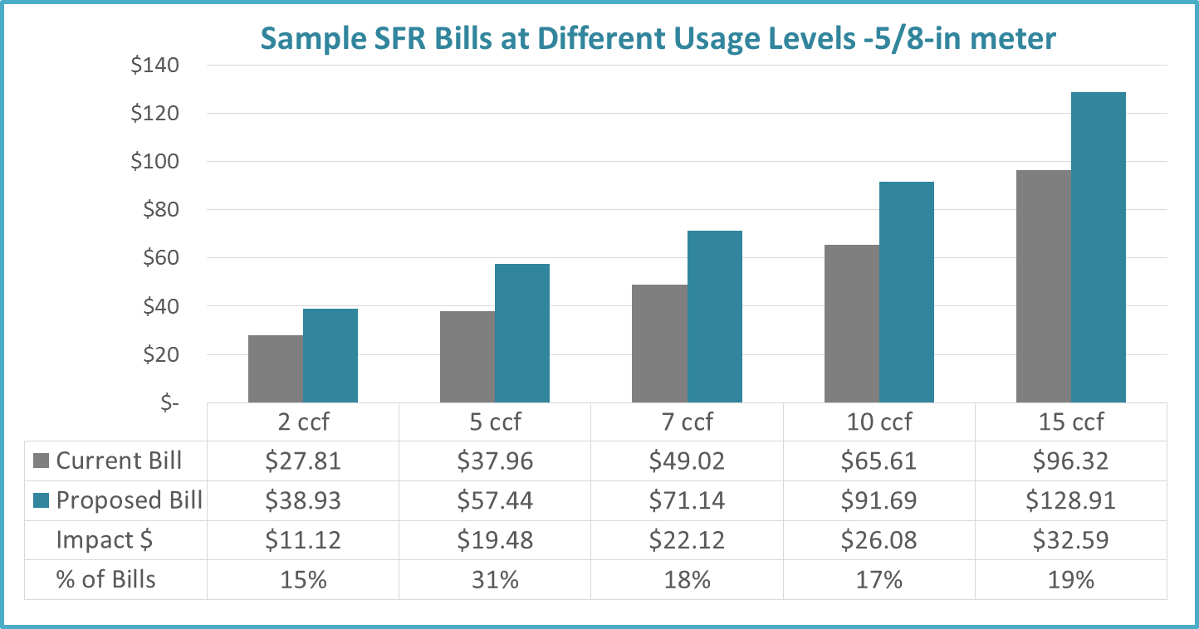
Option 1B – 90% Variable / 10% Fixed
SFR Sample Impacts

Slide 42
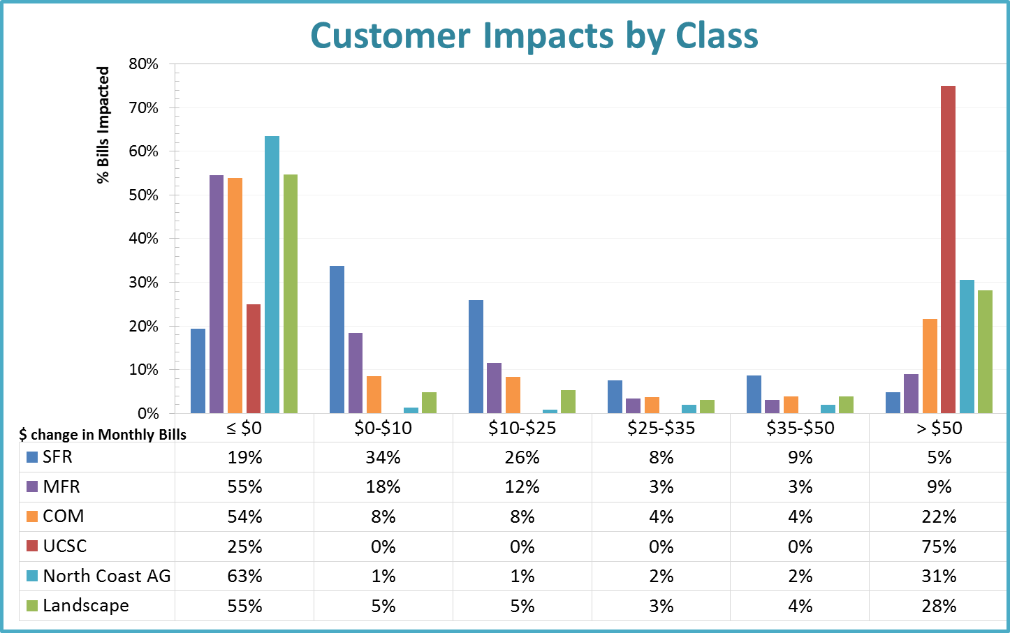
Option 1B - 90% Variable / 10% Fixed
Customer Impacts by Class ($)

Slide 43
Option 1B – 90% Variable / 10% Fixed
Customer Impacts by Class (%)

Slide 44
Scenario 2
Base Rate: ~60% Variable / ~40% Fixed

Slide 45
Scenario 2 Options
Option 2A
  Base Rates - 60% Variable / 40% Fixed
  IRF – 100% Commodity
Option 2B
  Base Rates – 60% Variable / 40% Fixed
  IRF – 100% Fixed based on AWWA Meter Ratio

Slide 46
Option 2A
60% Variable / 40% Fixed
IRF – 100% Commodity

Slide 47
Option 2A – 60% Variable / 40% Fixed
Inside Fixed Charge
Meter Size | Proposed Inside Ready-to-Serve ($/Meter) | Current Inside | Difference ($) | Difference (%)
5/8-in | $26.06 | $23.19 | $2.57 | 11%
3/4-in | $34.92 | $23.19 | $11.52 | 50%
1-in | $52.89 | $57.94 | -$5.23 | -9%
1 1/2-in | $97.01 | $115.88 | -$15.11 | -13%
2-in | $151.37 | $185.38 | -$23.86 | -13%
3-in | $334.12 | $347.59 | -$9.18 | -3%
4-in | $582.92 | $579.32 | $22.12 | 4%
6-in | $1,437.03 | $1,158.60 | $313.79 | 27%
8-in | $2,492.14 | $2,664.74 | -$187.42 | -7%
10-in | $3,722.34 | $3,290.36 | $415.40 | 13%

Slide 48
Option 2A – 60% Variable / 40% Fixed
Outside Fixed Charge
Meter Size | Proposed Outside Ready-to-Serve ($/Meter) | Current Outside | Difference ($) | Difference (%)
5/8-in | $29.85 | $29.56 | -$0.06 | 0%
3/4-in | $40.01 | $29.56 | $10.20 | 35%
1-in | $60.59 | $73.88 | -$13.50 | -18%
1 1/2-in | $111.12 | $147.72 | -$32.29 | -22%
2-in | $173.39 | $236.35 | -$51.33 | -22%
3-in | $382.73 | $443.17 | -$55.53 | -13%
4-in | $667.73 | $738.62 | -$49.68 | -7%
6-in | $1,646.10 | $1,477.21 | $209.39 | 14%
8-in | $2,854.71 | $3,398.51 | -$560.77 | -17%
10-in | $4,263.89 | $4,195.23 | $49.68 | 1%

Slide 49
Option 2A
Inside Commodity Rates
Commodity | Proposed Tier | O&M Rates | IRF Rates | Total Inside Commodity Rate | Current Commodity Rate
SFR
Tier 1 | 0-5 | $3.58 | $1.55 | $5.13 | $2.11
Tier 2 | 6-7 | $4.26 | $2.32 | $6.58 | $5.33
Tier 3 | 8-9 | $5.25 | $2.87 | $8.12 | $6.86
Tier 4 | & Above | $6.63 | $3.86 | $10.48 | $9.40
Tier 5 |  |  |  |  | $11.71
MFR
Tier 1 | 0-5 | $3.58 | $1.55 | $5.13 | $5.33
Tier 2 | 6-7 | $4.26 | $2.32 | $6.58 | $5.33
Tier 3 | 8-9 | $5.25 | $2.87 | $8.12 | $5.33
Tier 4 | & Above | $6.63 | $3.86 | $10.48 | $5.33
Tier 5 |  |  |  |  | $5.33
COM
Uniform | Uniform | $4.41 | $2.27 | $6.68 | $5.33
UCSC
Uniform | Uniform | $4.54 | $2.40 | $6.94 | $5.33
North Coast AG
Uniform | Uniform | $3.58 | $3.05 | $6.63 | $1.70
Landscape
Tier 1 | 100% of TWB* | $4.69 | $2.82 | $7.51 | $5.33
Tier 2 | 150% of TWB | $6.99 | $4.22 | $11.21 | $5.33
Tier 3 | & Above | $8.10 | $4.27 | $12.38 | $5.33
Elevation Surcharge
Elevation Surcharge |  |  |  | $0.42 | $0.20

Slide 50
Option 2A
Outside Commodity Rates
Commodity | Proposed Tier | O&M Rates | IRF Rates | Total Outside Commodity Rate | Current Commodity Rate
SFR
Tier 1 | 0-5 | $4.11 | $1.78 | $5.90 | $2.67
Tier 2 | 6-7 | $4.89 | $2.68 | $7.57 | $6.80
Tier 3 | 8-9 | $6.06 | $3.31 | $9.37 | $8.74
Tier 4 | & Above | $7.67 | $4.44 | $12.12 | $11.96
Tier 5 |  |  |  |  | $14.94
MFR
Tier 1 | 0-5 | $4.11 | $1.78 | $5.90 | $6.80
Tier 2 | 6-7 | $4.89 | $2.68 | $7.57 | $6.80
Tier 3 | 8-9 | $6.06 | $3.31 | $9.37 | $6.80
Tier 4 | & Above | $7.67 | $4.44 | $12.12 | $6.80
Tier 5 |  |  |  |  | $6.80
COM
Uniform | Uniform | $5.05 | $2.60 | $7.65 | $6.80
UCSC
Uniform | Uniform | N/A |  |  | $6.80
North Coast AG
Uniform | Uniform | N/A |  |  | $1.70
Landscape
Tier 1 | 100% of TWB* | $5.37 | $3.23 | $8.61 | $6.80
Tier 2 | 150% of TWB | $8.00 | $4.84 | $12.84 | $6.80
Tier 3 | & Above | $9.28 | $4.90 | $14.18 | $6.80
Elevation Surcharge
Elevation Surcharge |  |  |  | $0.48 | $0.20

Slide 51

Option 2A – 60% Variable / 40% Fixed
SFR Sample Impact

Slide 52
Option 2A – 60% Variable / 40% Fixed
Customer Impacts by Class ($)

Slide 53
Option 2A – 60% Variable / 40% Fixed
Customer Impacts (%)

Slide 54
Option 2B
60% Variable / 40% Fixed
IRF – 100% Fixed – AWWA Ratios

Slide 55
Option 2B – 60% Variable / 40% Fixed
Inside Fixed Charge
Meter Size | Proposed Inside Fixed Charge ($/Meter) | Current Inside | Difference ($) | Difference (%)
5/8-in | $43.87 | $23.19 | $20.38 | 88%
3/4-in | $61.63 | $23.19 | $38.23 | 165%
1-in | $97.41 | $57.94 | $39.29 | 68%
1 1/2-in | $186.04 | $115.88 | $73.92 | 64%
2-in | $293.81 | $185.38 | $118.58 | 64%
3-in | $645.70 | $347.59 | $302.40 | 87%
4-in | $1,143.75 | $579.32 | $582.95 | 101%
6-in | $2,861.36 | $1,158.60 | $1,738.12 | 150%
8-in | $4,984.72 | $2,664.74 | $2,305.16 | 87%
10-in | $7,461.21 | $3,290.36 | $4,154.27 | 126%

Slide 56
Option 2B – 60% Variable / 40% Fixed
Outside Fixed Charge
Meter Size | Proposed Outside Fixed Charge ($/Meter) | Current Outside | Difference ($) | Difference (%)
5/8-in | $50.25 | $29.56 | $20.34 | 69%
3/4-in | $70.61 | $29.56 | $40.80 | 138%
1-in | $111.58 | $73.88 | $37.49 | 51%
1 1/2-in | $213.10 | $147.72 | $69.69 | 47%
2-in | $336.55 | $236.35 | $111.83 | 47%
3-in | $739.64 | $443.17 | $301.38 | 68%
4-in | $1,310.16 | $738.62 | $592.75 | 80%
6-in | $3,277.66 | $1,477.21 | $1,840.95 | 125%
8-in | $5,709.93 | $3,398.51 | $2,294.45 | 68%
10-in | $8,546.72 | $4,195.23 | $4,332.51 | 103%

Slide 57
Option 2B
Inside Commodity Rates
Commodity | Proposed Tier | Proposed Commodity Rate | Current Commodity Rate
SFR
Tier 1 | 0-5 | $3.58 | $2.11
Tier 2 | 6-7 | $4.26 | $5.33
Tier 3 | 8-9 | $5.25 | $6.86
Tier 4 | & Above | $6.63 | $9.40
Tier 5 |  |  | $11.71
MFR
Tier 1 | 0-5 | $3.58 | $5.33
Tier 2 | 6-7 | $4.26 | $5.33
Tier 3 | 8-9 | $5.25 | $5.33
Tier 4 | & Above | $6.63 | $5.33
Tier 5 |  |  | $5.33
COM
Uniform | Uniform | $4.41 | $5.33
UCSC
Uniform | Uniform | $4.54 | $5.33
North Coast AG
Uniform | Uniform | $3.58 | $1.70
Landscape
Tier 1 | 100% of TWB | $4.70 | $5.33
Tier 2 | 150% of TWB | $6.99 | $5.33
Tier 3 | & Above | $8.11 | $5.33
Elevation Surcharge
Elevation Surcharge |  | $0.42 | $0.20

Slide 58
Option 2B
Outside Commodity Rates
Commodity | Proposed Tier | Proposed Commodity Rate | Current Commodity Rate
SFR
Tier 1 | 0-5 | $4.12 | $2.67
Tier 2 | 6-7 | $4.90 | $6.80
Tier 3 | 8-9 | $6.06 | $8.74
Tier 4 | & Above | $7.68 | $11.96
Tier 5 |  |  | $14.94
MFR
Tier 1 | 0-5 | $4.12 | $6.80
Tier 2 | 6-7 | $4.90 | $6.80
Tier 3 | 8-9 | $6.06 | $6.80
Tier 4 | & Above | $7.68 | $6.80
Tier 5 |  |  | $6.80
COM
Uniform | Uniform | $5.05 | $6.80
UCSC
Uniform | Uniform | N/A | $6.80
North Coast AG
Uniform | Uniform | N/A | $1.70
Landscape
Tier 1 | 100% of TWB | $5.38 | $6.80
Tier 2 | 150% of TWB | $8.01 | $6.80
Tier 3 | & Above | $9.29 | $6.80
Elevation Surcharge
Elevation Surcharge |  | $0.48 | $0.20

Slide 59
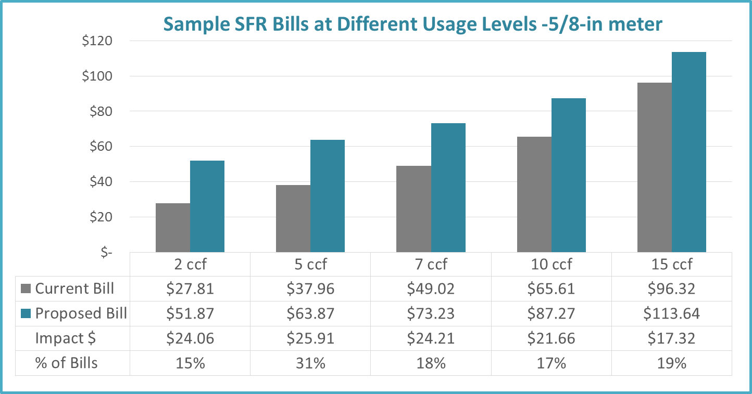
Option 2B – 60% Variable / 40% Fixed
SFR Sample Impact

Slide 60
Option 2B – 60% Variable / 40% Fixed
Customer Impacts by Class ($)

Slide 61
Option 2B – 60% Variable / 40% Fixed
Customer Impacts (%)

Slide 62
Pricing Objectives

Slide 63
Conservation Pricing Objectives
Equity
Appropriate Funding Mechanisms
Rate Stability & Affordability
Rate Stability
Promotes Efficiency / Conservation
Promotes Conservation
Administration
Customer Understanding
Revenue Stability
Revenue Sufficiency
Potential Funding Mechanism for Alt. Water Supply & Conservation Programs
Mitigate Customer Impact
Affordability for Essential Use
Equitable in Allocating CIP Cost
Easy to Implement
Easy to Administer
Tool for Drought Management Action Plan
Promotes Efficiency
Rewards Past Conservation Effort
Economic Development
Perceived to be Fair to the Public
Align Supply & Demand
Based on Individual Needs
Scientific Method

Slide 64
Pricing Objective Exercise
Most Important / Critical = 1; Very Important = 2; Important = 3; Least Important = 4
Importance Rankings | Pricing Objectives | Average
Most Important | Revenue Sufficiency | 1.1
Very Important | Promotes Efficiency | 1.6
 | Revenue Stability | 1.7
 | Perceived to be Fair to the Public | 1.8
 | Affordability for Essential Use | 1.8
 | Customer Understanding | 1.9
 | Promotes Conservation | 2.0
 | Rate Stability | 2.0
Important | Tool for Drought Management Action Plan | 2.3
 | Equitable in Allocating CIP Cost | 2.4
 | Potential Funding Mechanism for Alt. Water Supply & Conservation Programs | 2.4
 | Scientific Method | 2.4
 | Align Supply & Demand | 2.6
 | Mitigate Customer Impact | 2.7
Least Important | Economic Development | 2.9
 | Easy to Administer | 2.9
 | Rewards Past Conservation Effort | 3.1
 | Easy to Implement | 3.1
 | Based on Individual Needs | 3.2
Notes:
Includes the City Council and Water Commission Rankings

Slide 65
Boils down to
Do we want a rate structure that achieves affordability / promotes conservation?
Or do we want to achieve revenue / rate stability?
What is the main purpose of the water rate structure?

Slide 66
Pricing Objective Exercise
Most Important / Critical = 1; Very Important = 2; Important = 3; Least Important = 4
Importance Rankings | Pricing Objectives | Average
Most Important | Revenue Sufficiency | 1.1
Very Important | Promotes Efficiency | 1.6
 | Revenue Stability | 1.7
 | Perceived to be Fair to the Public | 1.8
 | Affordability for Essential Use | 1.8
 | Customer Understanding | 1.9
 | Promotes Conservation | 2.0
 | Rate Stability | 2.0
Important | Tool for Drought Management Action Plan | 2.3
 | Equitable in Allocating CIP Cost | 2.4
 | Potential Funding Mechanism for Alt. Water Supply & Conservation Programs | 2.4
 | Scientific Method | 2.4
 | Align Supply & Demand | 2.6
 | Mitigate Customer Impact | 2.7
Least Important | Economic Development | 2.9
 | Easy to Administer | 2.9
 | Rewards Past Conservation Effort | 3.1
 | Easy to Implement | 3.1
 | Based on Individual Needs | 3.2
Notes:
Includes the City Council and Water Commission Rankings

Slide 67
Summary of Scenarios
Option 1A
  Normal Rates with RTS and Tiered Rates - 90% Variable / 10% Fixed
  IRF – 100% Commodity
Option 1B
  Normal Rates with RTS and Tiered Rates - 90% Variable / 10% Fixed
  IRF – 100% Fixed
Option 2A
  Normal Rates with RTS and Tiered Rates - 60% Variable / 40% Fixed
  IRF – 100% Commodity
Option 2B
  Normal Rates with RTS and Tiered Rates - 60% Variable / 40% Fixed
  IRF – 100% Fixed

Slide 68
Summary of Rate Scenario Impact
 | Proposed SFR Bills - Inside, 5/8" Meter, includes Elevation Surcharge
 | 2 ccf | 5 ccf | 7 ccf | 10 ccf | 15 ccf
Option 1A | $24.22 | $47.38 | $65.72 | $93.23 | $143.67
Option 1B | $38.93 | $57.44 | $71.14 | $91.69 | $128.91
Option 2A | $37.16 | $53.81 | $67.81 | $88.81 | $128.43
Option 2B | $51.87 | $63.87 | $73.23 | $87.27 | $113.64

Slide 69
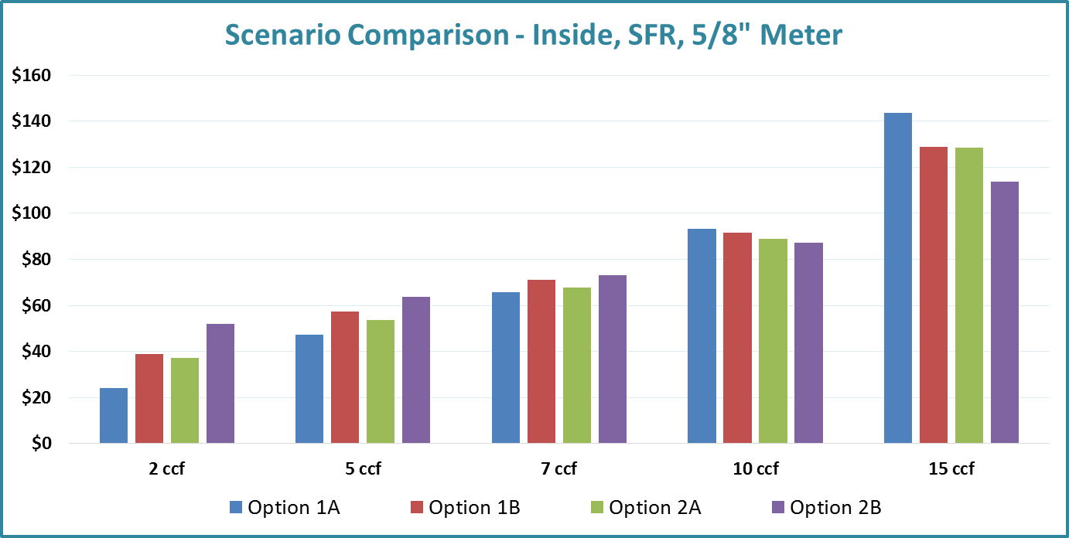
Summary

Slide 70
Summary of Financial Stability
Scenarios | Option 1A | Option 1B | Option 2A | Option 2B
Fixed | 8% | 31% | 31% | 54%
Tier 1 | 40% | 31% | 29% | 20%
Tier 2 | 8% | 6% | 6% | 4%
Tier 3 | 6% | 4% | 5% | 3%
Tier 4 | 11% | 8% | 9% | 6%
Uniform | 26% | 20% | 20% | 14%
Total | 100% | 100% | 100% | 100%
Notes:
May not add to 100% due to rounding

Slide 71
Evaluated Scenarios
Normal Rates with RTS and Tiered Rates ($25.9M)
  90% Variable / 10% Fixed
  60% Variable / 40% Fixed
IRF ($7.8M)
  100% Commodity
  100% Fixed based on Meter Size (AWWA Ratio)
Total of 4 scenarios were evaluated

